Slide 1

Do you Know your new colleagues…

Slide 2
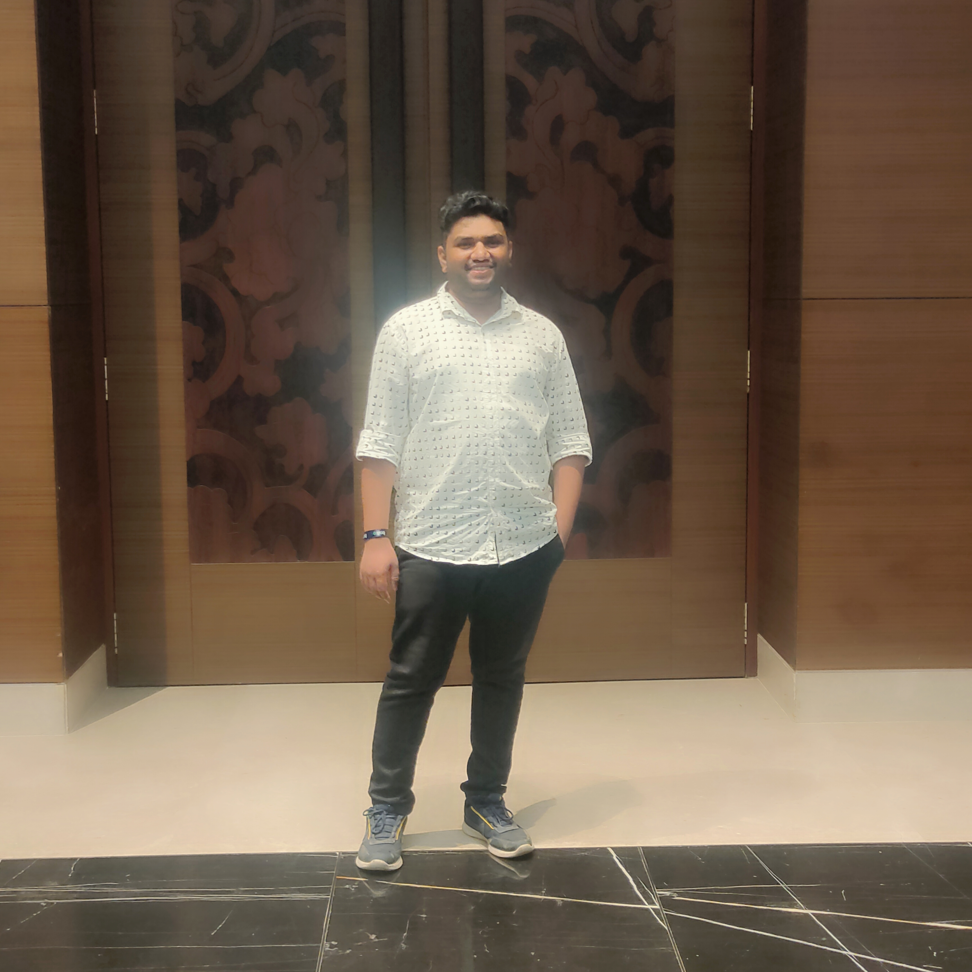
NAME: PRATIK VALVI
My Profile: Optimistic and enthusiastic Software Development Engineer with 3+ years of experience in crafting innovative solutions.
From: Born in Nandurbar city and brought up in city of seven hills called Satara in Maharashtra.
Quote that describes you:“I believe whatever doesn't challenge you simply keeps you away from becoming the best version of yourself”
Fun facts about you (truly Fun :P): Huge fan of Marvel Cinematic Universe and love to plan trips and go on long drive with loved ones.

